Slide 1
CREATE UNIT TEST CASE DOCUMENT WITH PROGRAM CHECK LIST
SPECIAL JAVA SUBJECT FSOFT – Developer – Part1

Slide 2
Agenda
Overview
What is PCL
Sheets are in PCL:
Cover sheet
FunctionList heet
Test Report sheet
Test function sheets
Content in Test function sheet
Combination of test cases.
Condition and confirmation of Test cases.
Other items:
Function Code, Function Name, Created By, Executed By, Lines of code, Test requirement
Examples: a example
Real code
PCL for real code (function)

Slide 3
Overview
What is PCL (Program Check List)

Slide 4
Overview
Cover sheet: General information of the project and Unit Test cases
FunctionList sheet:
The list of Classes and Functions to be tested.
To control that the number of Unit TC meets customer's requirement or the norm, user should fill value for
'Normal number of Test cases/KLOC'
Click on Function link to open the related Test cases of the function.
Test Report sheet: provide the overview results of Unit test:
Test coverage
Test successful coverage
Summary: Normal/Abnormal/Boundary cases

Slide 5
Content of Function
Information: The list of Classes and Functions to be tested.
Function name/Code
Number LOC
Number of lack TCs
Test requirement: brief description of function to be tested
Number of TC: Normal, Abnormal, Boundary (automatically)
Test Case: Combination of:
Condition
Confirmation

Slide 6
Condition
Precondition:
Setting condition that must exist before execution of the test case.
Example: file A is precondition for the test case that needs to access file A.
Values of input: 3 types
Normal: used mainly to ensure the function works
Boundary: limited values that contain upper and lower values
Abnormal: non-expected values (processes exception cases)
Example: 5<= input <= 10
N: 6, 7, 8, 9
B: 5, 10
A: -1, 4, 11

Slide 7
Confirmation
Confirmation is expected result to check output of each function
Can include:
Output result
Output log messages in log file
Output screen messages
Test case result:
P/OK: Passed
F/NG: Failed

Slide 8
Unit Testing Execution
SPECIAL JAVA SUBJECT FSOFT – Developer – Part1

Slide 9
Agenda
Software testing levels
Manual unit testing
Unit Testing based on UT cases
Automated Unit Testing
Automated Unit Testing with NUnit
Automated Tests vs. Manual Tests
Best Practices

Slide 10
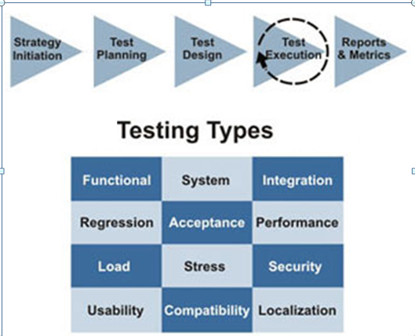
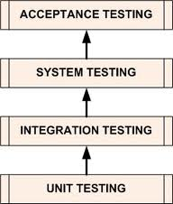
Too many of Software Testing Levels
Process
Manual test
Automatic test
Process
Traditional Test process
Test driven Development
Notes:
Software testing view theo nhiều hướng:
Theo chiều dọc
Theo chiều ngang
Theo quy trình tiến hành

Slide 11
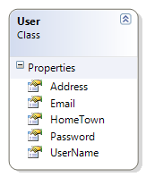
How we test this function?
Requirement :
- Write a module to add an User to DataBase
Business rule :
- Email can not be duplicated
- Email must be in valid form
- UserName ‘s length must be > 8
- UserName can not be dupplicated
- Password length must be > 8
Notes:
Giảng viên write a simple method to test như trên

Slide 12
Manual Unit Testing
Write code
Uploading the code to some place
Build it
Running the code manually (in many cases filling up forms etc step by step)
Check Log files, Database, External Services, Values of variable names, Output on the screen etc
If it does not work, repeat the above process
Notes:
Giang vien demo traditional tesst

Slide 13
Manual Unit Testing - Limitation
Developer nhớ được trường hợp nào thì test trường hợp đó
Đến cuối dự án số lượng test case càng lúc càng nhiều, khả năng cover của lập trình viên giảm xuống!
Nhiều test case bị trùng lắp
Nhiều test case bị lack
Team lead không thể review hết được
➔ Kết quả dự án chỉ trông chờ vào tester!!!!
➔ Rất nhiều lỗi phát sinh sau khi system test, đa phần các lỗi xuất phát do Dev test không kỹ từ lúc Unit Test!
Notes:
Giảng viên write a simple method to test như trên

Slide 14
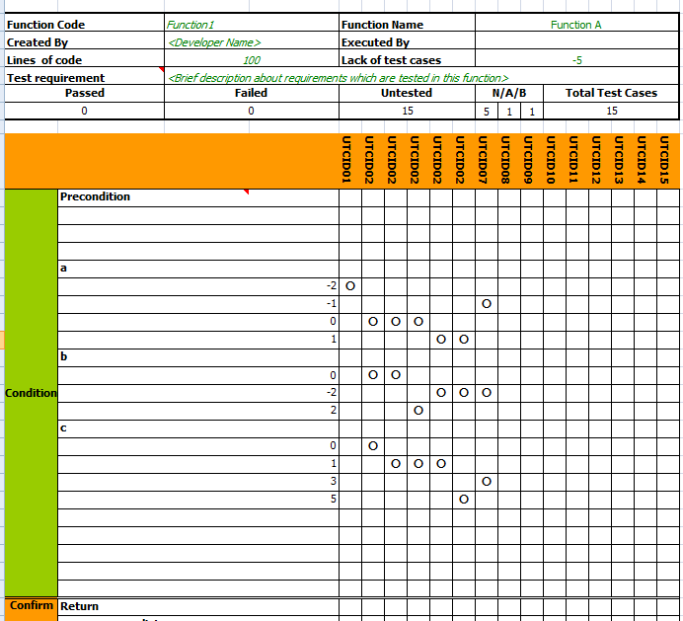

Unit Testing based on UT cases
Để giải quyết vấn đề trên Mỗi khi developer test xong phải viết tài liệu mô tả test case trên word hoặc excel !
Điều này giúp team rất dễ dàng review.. Tuy nhiên, cách làm này sẽ phát sinh ra rất nhiều hạn chế!
Notes:
Giảng viên write a simple method to test như trên, dùng template

Slide 15

Unit Testing based on UT cases
Các dự án lớn thì số lượng tài liệu test case thường cũng rất lớn!
Các dự án lớn thì requirement thường hay thay đổi
Mỗi khi requirement thay đổi➔ Phải sửa code➔ phải cập nhật lại tài liệu testcase ➔và lại manual retest , rất tốn effort➔Càng đến cuối dự án, lượng việc sinh ra càng nhiều , viết test case document trở thành “địa ngục “ thực sự !➔ dev không còn đủ effort update test case document, tài liệu nhanh chóng bị lạc hậu, hoặc việc update chỉ là đối phó!
Một số trường hợp không thể dùng Excel Unit TestCase
So, what is the solution?
Notes:
Giảng viên trình bày nhược điểm

Slide 16
Automated Unit Testing First Step
Coding Process with Automated Unit Tests
Write code
Write one or more test cases script
Auto-compile and run
If tests fail -> make appropriate modifications
If tests pass -> repeat for next method

Slide 17
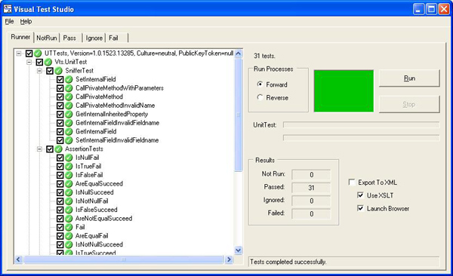
Automated Unit Testing: Common Tools
UT Tools for references:
Java: JUnit, J2MEUnit
C/C++: cppUnit
Python: pyUnit
Perl: PerlUnit
Visual Basic: vbUnit
C# .NET: Nunit,csUnit
Refferences:
http://www.testingfaqs.org/t-unit.html
www.junit.org
http://www.codeproject.com/gen/design/autp5.asp

Slide 18
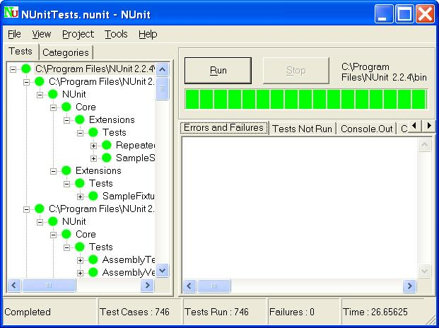
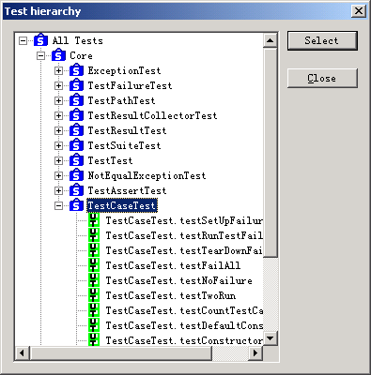
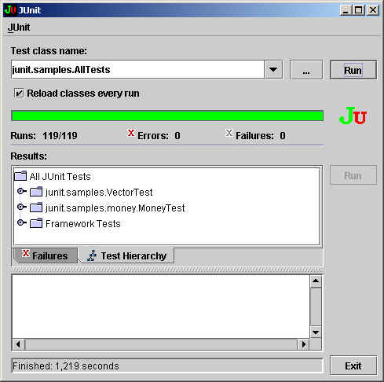
Automated Unit Testing: Common Tools
http://sourceforge.net/projects/cppunit/
http://www.nunit.org
http://www.junit.org/

Slide 19
Automated Unit Testing Demo
Notes:
Giảng viên demo cách viết sử dụng manual code, sử dụng code có sẵn trong thư mục “UnitTest.Demo”

Slide 20

Automated Unit Testing with NUnit What is NUnit?
Milk ? Beer or Coffee?
NUnit – an open source test tool for .NET
Useful for development and regression
Leads to a design-for-test approach
Tests can be written in VB.NET or C#

Slide 21

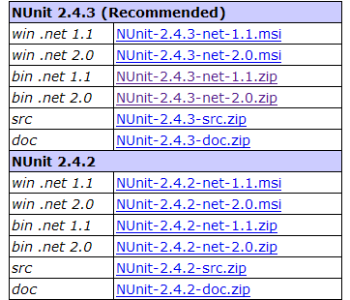
Automated Unit Testing with NUnit Where to get NUnit?
Let’s go to website: http://www.nunit.org/index.php?p=download
Yeahh, I got it

Slide 22
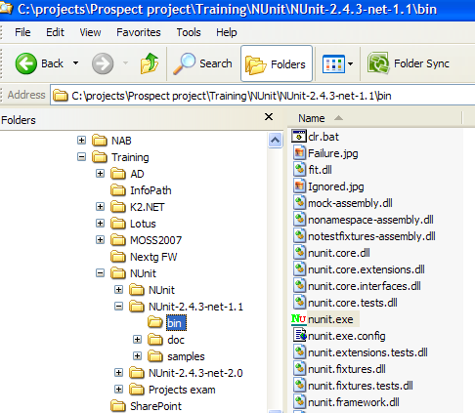

Automated Unit Testing with NUnit Where to get Nunit? - Extract to any folder
mumm, it is easy

Slide 23
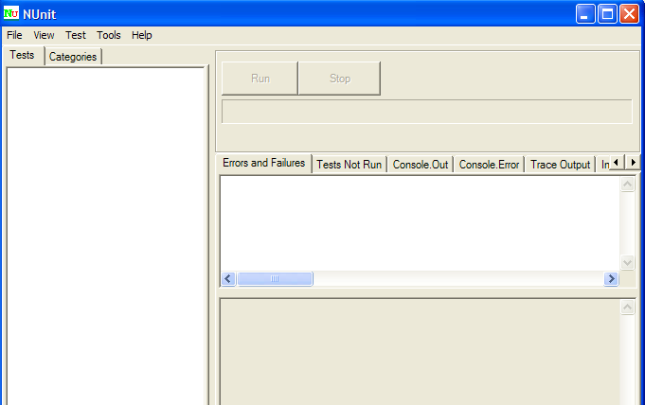

Automated Unit Testing with Nunit Screens of tool
Yeahh, It tastes good

Slide 24

Automated Unit Testing with Nunit How to use NUnit?
Create a test case base on NUnit framework
Deploy and Run
Who knows…

Slide 25

Automated Unit Testing with Nunit Create a test case
Step 1: Create a Class
Step 2: Add a reference nunit.Framework.dll to this class
Step 3: Add a reference to *.dll contains function which you want to do Unit test
Step 4: Restructure class following Nunit frame work
Step 5: Write a test case
Let’s me go…

Slide 26
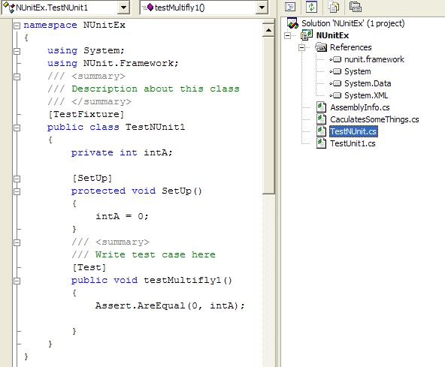
Automated Unit Testing with Nunit Create a test case
Step 1: Create a Class
Step 2: Add a reference nunit.Framework.dll to this class
Step 3: Add a reference to *.dll contains function which you want to do Unit test
Step 4: Restructure class following Nunit frame work

Slide 27

Automated Unit Testing with Nunit Create a test case
Step 5: Write a test case
Each test case will be a function/method of class
Must have attribute [Test] above a function/method
Ex:
[Test]
public void testCase1()
{
Assert.AreEqual(0, intA);
}
[Test]
public void testCase2()
{
Assert.AreEqual(0, divides(intA, intB));
}
Beer Please !!!

Slide 28
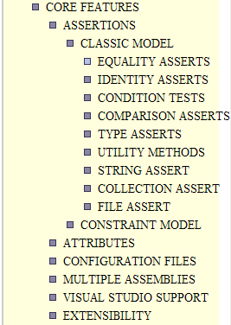
Automated Unit Testing with Nunit Core Features
Core Features to code a test case
Assertions
Equality Assserts:
Ex: Assert.AreEqual( int expected, int actual );
Condition Tests:
Ex: Assert.IsTrue( bool condition );
Comparrison Asserts
Ex: Assert.Greater( int arg1, int arg2 );
Type Asserts
Ex: Assert.IsInstanceOfType( Type expected, object actual );
Utility methods
Ex: Assert.Fail();
String Assert
Ex: StringAssert.Contains( string expected, string actual );
Collection Asserts
Ex: CollectionAssert.AreEqual( Collection expected, Collection actual );
Attributes

Slide 29
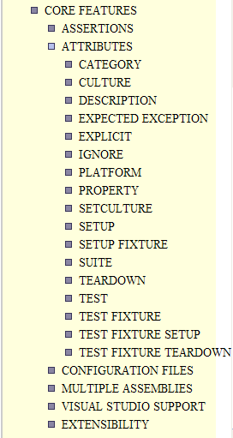
Automated Unit Testing with Nunit Core Features
Attributes
[TestFixture]
[Category("TestUnitExample")]
public class TestNUnit
{
private int intA;
private int intB;
private CaculatesSomeThings objCal;
[SetUp]
protected void SetUp()
{
intA = 0;
intB = 0;
objCal = new CaculatesSomeThings();
}
[Test]
Public void TestCase1()
{
Assert.AreEqual(0, objCal.Multifly(intA, intB))
}

Slide 30

Automated Unit Testing with Nunit Deploy and Run
Step 1: Compile a test case class to dll
Step 2: Run NUnit tool
Step 3: Open *.dll contains test case class
Step 4: Choose the test case you want to run
Step 5: Click run button to see the report
I don’t believe…

Slide 31
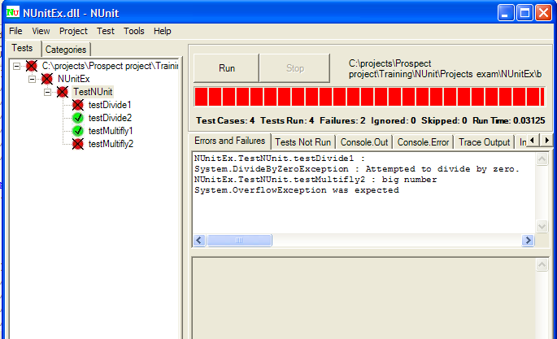

Automated Unit Testing with Nunit Deploy and Run
Quality… God let me sleep

Slide 32


